Slide 1
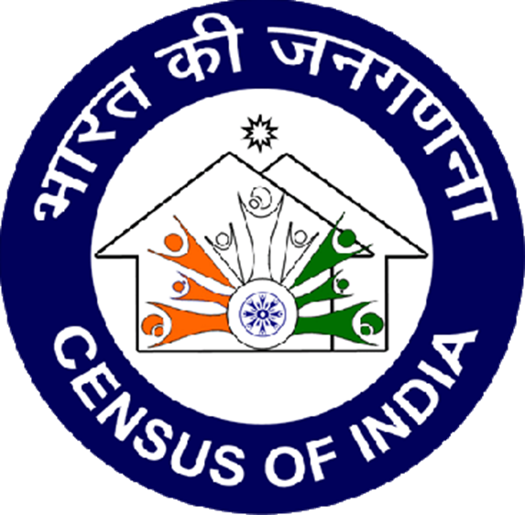

CENSUS DECODED

Slide 2

What is Data Analysis?
Data analysis is a process of inspecting, cleansing, transforming and modeling data with the goal of discovering useful information.

Slide 3

DATA SOURCE
KAGGLE is an online community of data scientists and machine learners, owned by Google. Kaggle allows users to find and publish data sets, explore and build models in a web-based data-science environment, work with other data scientists.

Slide 4

ABOUT DATASET
This dataset is a created by merging two datasets, ‘Census 2011 of Indian Cities’ and ‘City wise number of graduates from Census 2011’.

Slide 5

1.ETL PROCESS

Slide 6
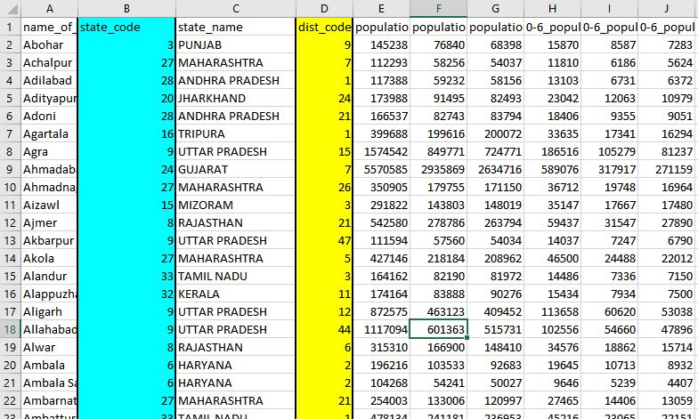
1.1 REMOVING UNWANTED COULUMNS FROM DATASET
*HIGHLIGHTED COLUMNS ARE NOT NECESSARY FOR ANALYSIS

Slide 7
1.2 GIVING PROPER NAMES TO COLUMNS
Before removing punctuation
After removing punctuation

Slide 8

ANALYSIS ON DATASET

Slide 9
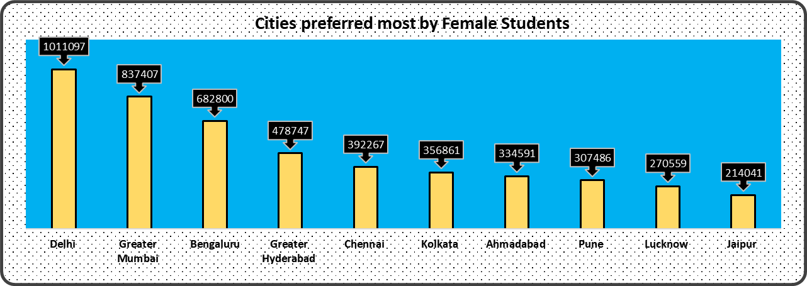

2 Which top 10 cities are most preferred by female students for graduation?

Slide 10
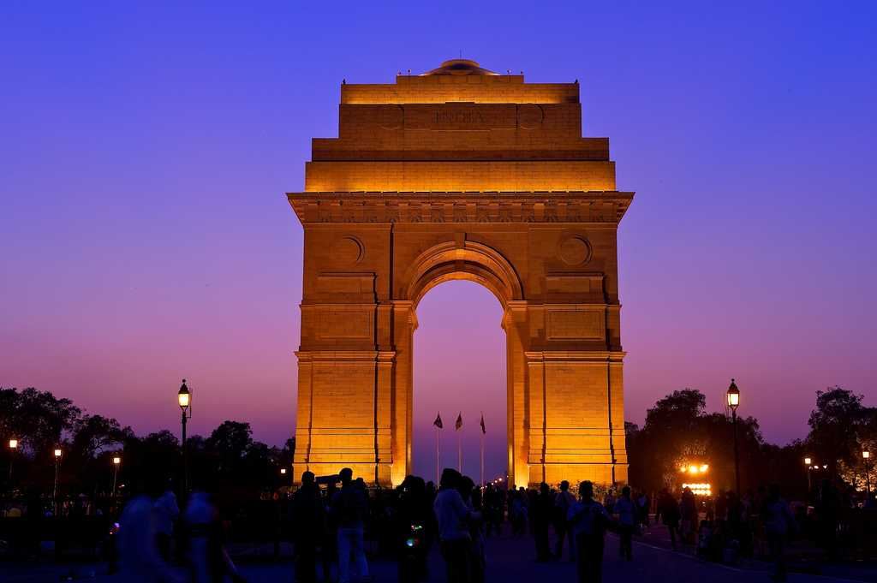
CONCLUSION
Delhi is the most preferred city for women education as it has the highest no. of females graduating from its colleges, that is 1011097 females.
Cities other than Delhi preferred for female education are Mumbai, Bengaluru, Hyderabad, Chennai, Kolkata, Ahmedabad, Lucknow, and Jaipur

Slide 11
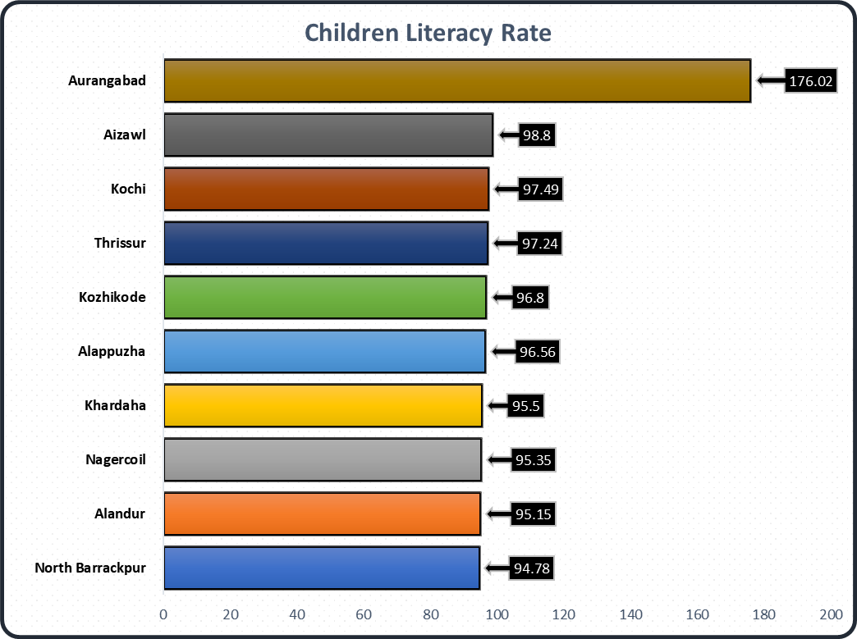
Which city emphasizes most on the education of children?

Slide 12
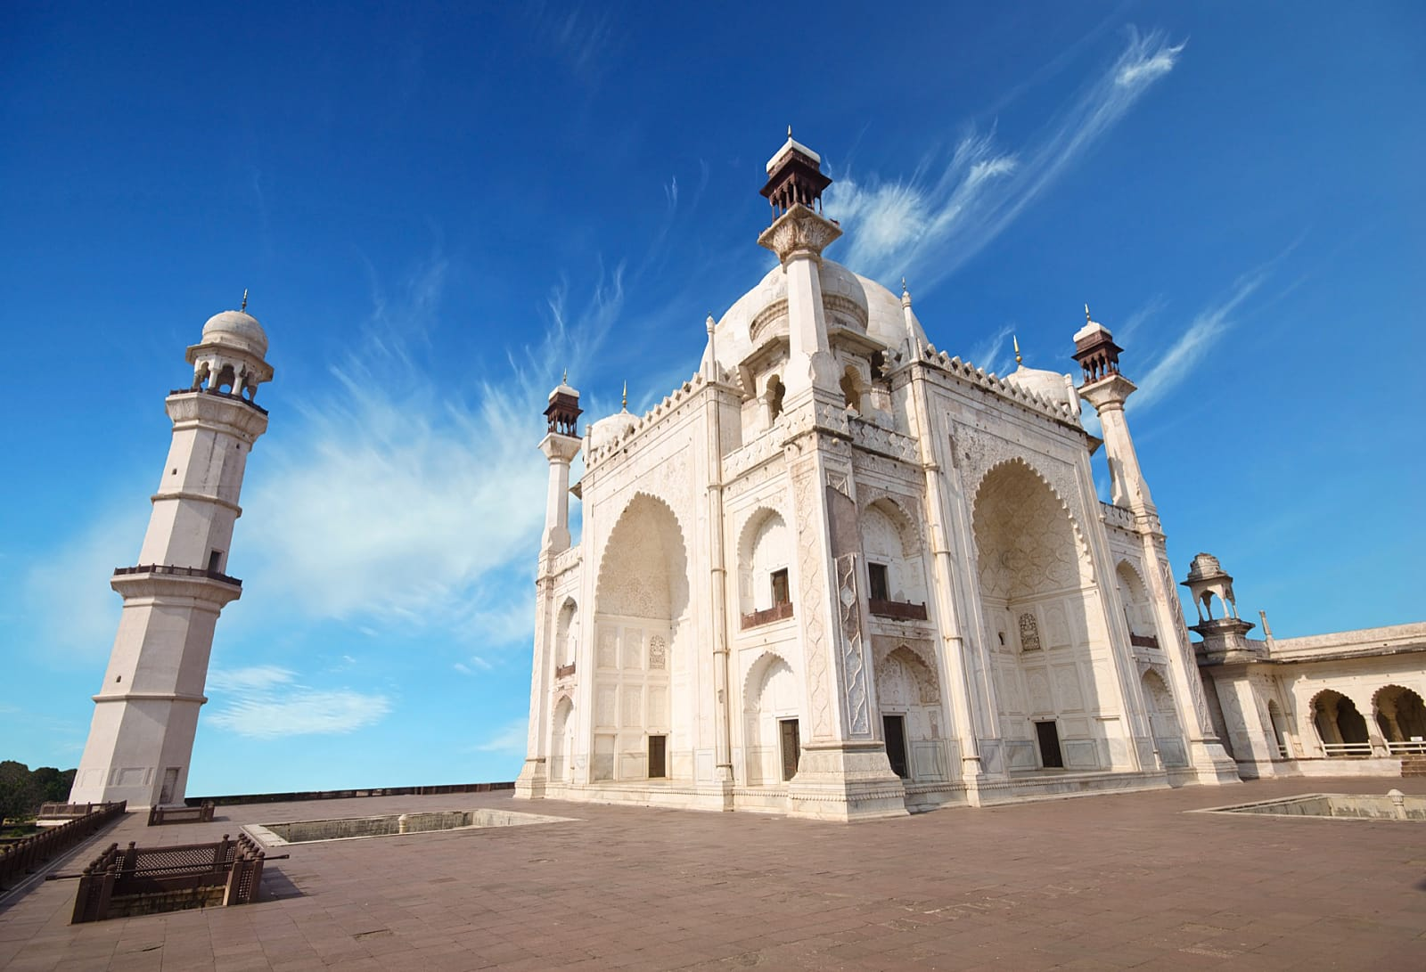
Conclusion
Aurangabad in Maharashtra emphasize most on education of children with highest effective literacy rate.
Other cities followed by Aurangabad are Aizawl, Kochi, Thrissur, Kozhikode, Alappauzha, Kharadha, Nagercoil, Alandur, and North Barrackpore.

Slide 13
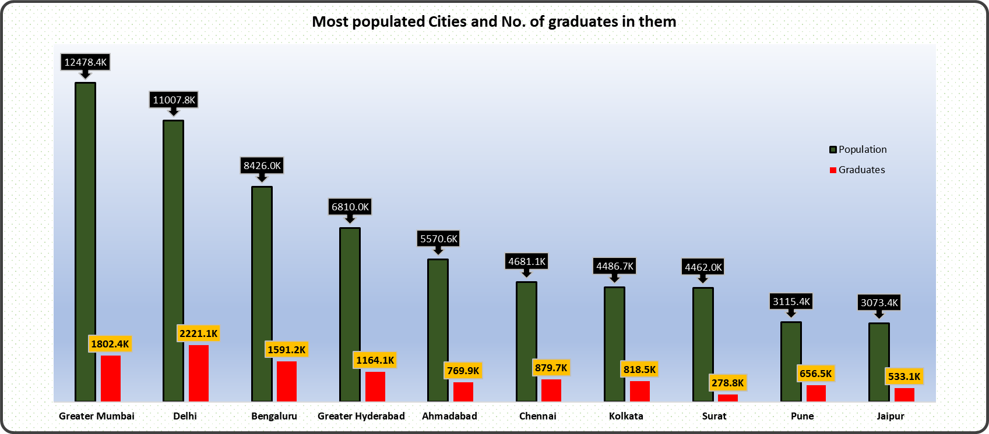
How many graduates are there in the top 10 most populous cities?

Slide 14
Conclusion
Greater Mumbai is the most populated city but still Delhi has more graduates than Mumbai. This shows that educational institutional in Delhi are better than Mumbai.
Surat also being in ‘Top 10 most populous city’ still has less no of graduates compared to other populous cities.

Slide 15
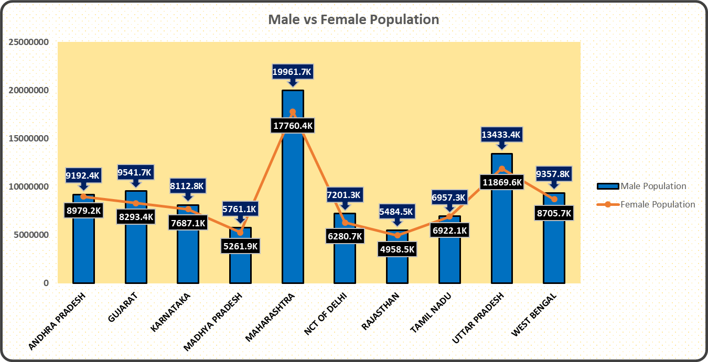
Comparison of Male and Female population across different states.

Slide 16
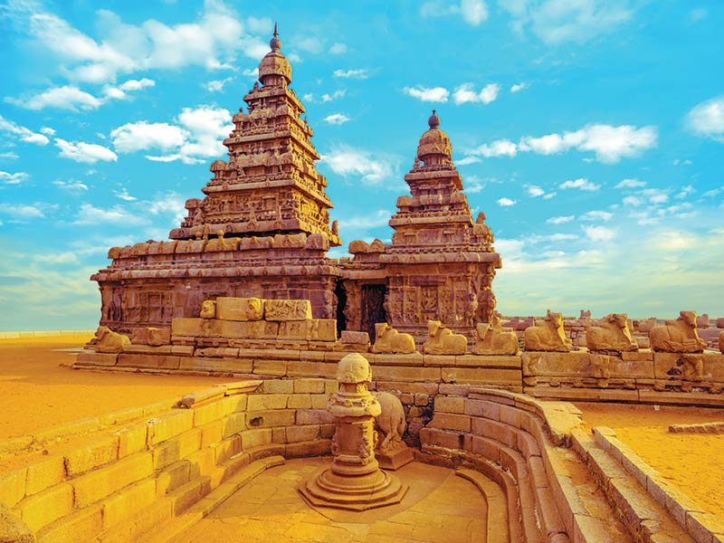
Conclusion
Tamil Nadu has almost similar ratio of male and female population that is 6957.3K and 6922.1K respectively.
Maharashtra has a uneven no. of male and female population with a difference of 22,01,336‬ people.

Slide 17
Which are the top 10 Indian cities with the best child sex ratio ?

Slide 18
Conclusion
Aurangabad in Maharashtra has the best child sex ratio that is 1752 followed by Bally, Nagaon, Tambram, Robertson Pet, Guwahati, Eluru, Puducherry and Kolar.
Most of the city with best child sex ratio are from South India.

Slide 19
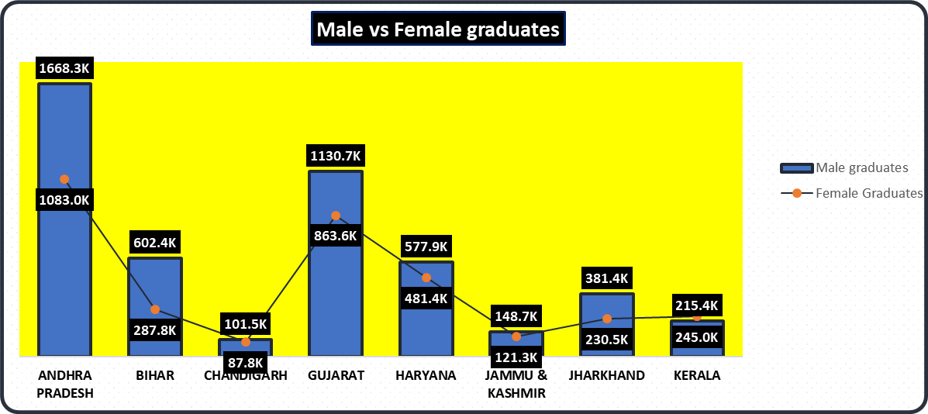
Comparison of male vs female graduates in state.

Slide 20

Conclusion
In Kerala there are more no. of female graduates than male graduates that is 244967 and 215434 respectively.
In most of the states there are more male graduates than female graduates.

Slide 21
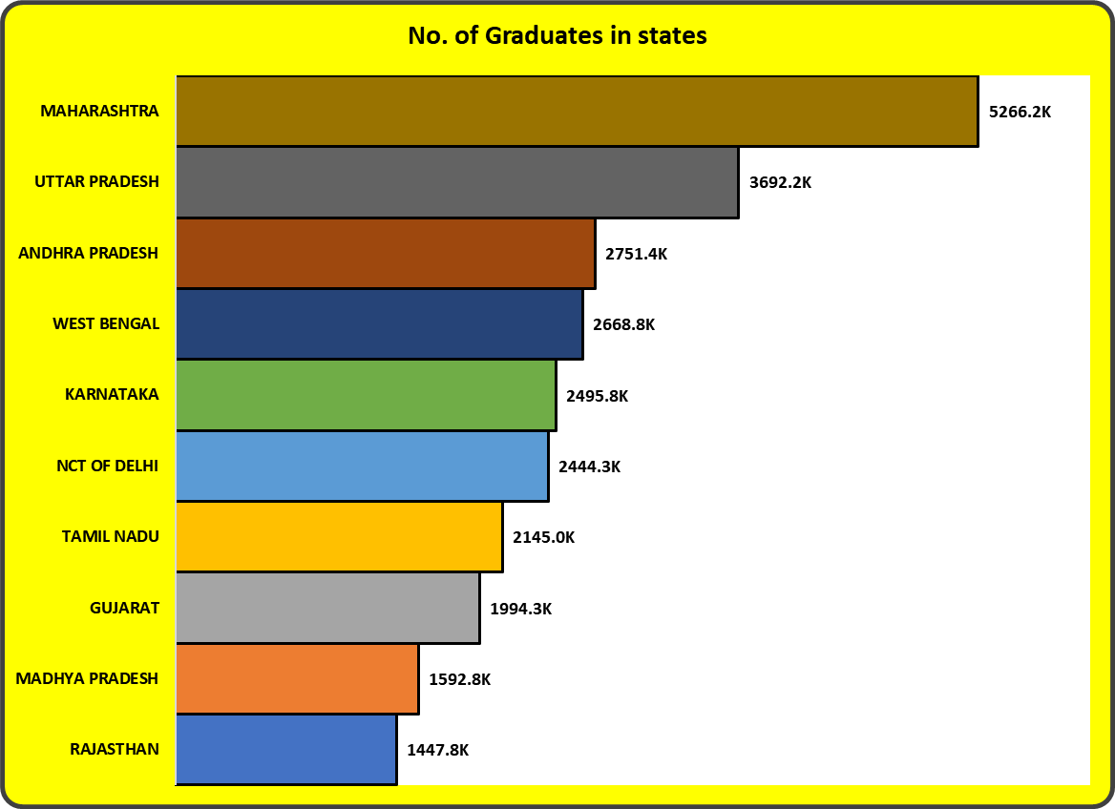
Which state is most preferred for graduation?

Slide 22

Conclusion
Maharashtra is the most preferred state for education as most of the graduates are from Maharashtra that is 5266151.
Other cities followed by Maharashtra are Uttar Pradesh, Andhra Pradesh, West Bengal, Karnataka, NCT of Delhi, Tamil Nadu, Gujarat, Madhya Pradesh, and Rajasthan.

Slide 23
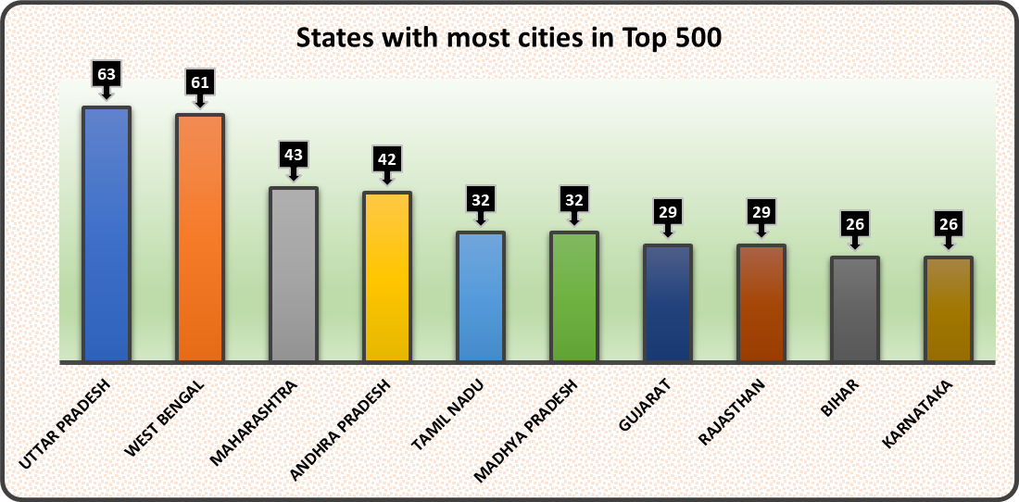
Which state is listed top by the number of cities in 500?

Slide 24

Conclusion
Uttar Pradesh has most no. of cities in top 500 and the reason is obvious as it has most of it’s cities with more than 1 lakh population.
Other cities followed by Uttar Pradesh are West Bengal, Maharashtra, Andhra Pradesh, Tamil Nadu, Madhya Pradesh, Gujarat, Rajasthan, Bihar, Karnataka.

Slide 25
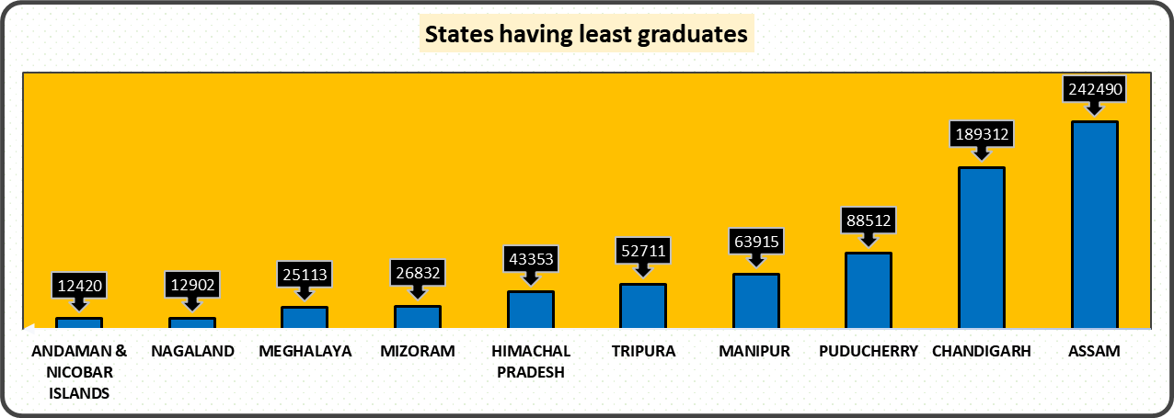
Which are the top 10 undeveloped states?

Slide 26

Conclusion
Andaman and Nicobar has least no. of graduates that is 12420 and reason for it is that the terrain and weather at this place is difficult.
Other states followed by Andaman and Nicobar are Nagaland, Meghalaya, Mizoram, Himachal Pradesh, Tripura, Manipur, Puducherry, Chandigarh, and Assam.

Slide 27
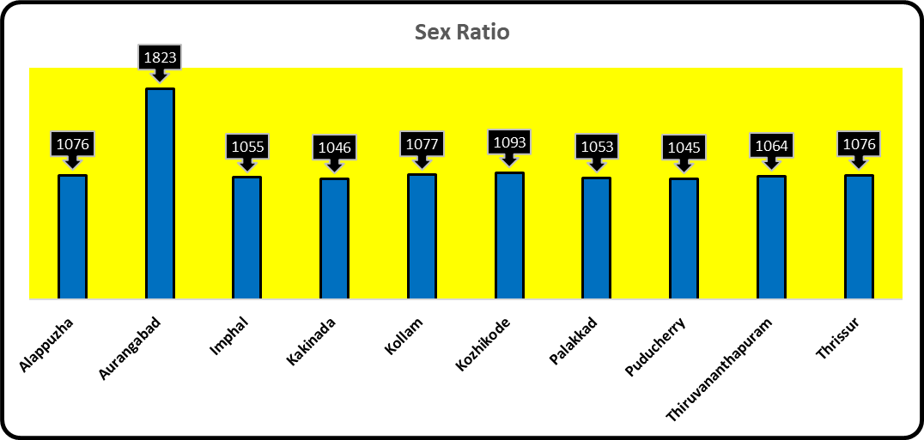
Which Indian cities have the best sex ratio in the top 500 Indian cities?

Slide 28
Conclusion
Aurangabad in Maharashtra has the best sex ratio that is 1823, it is followed by Kozhikode, Kollam, Thrissur, Alappuzha, Thiruvananthapuram, Imphal, Palakkad, Kakinada, Puducherry.
All the cities in top 10 are from South India.

Slide 29




THANK YOU!
AKASH PUNDIR
pundirakash@outlook.com
842-796-6993

